Slide 1
CS 4350: Fundamentals of Software Engineering Lesson 5.3 Evaluating Tests
Jonathan Bell, Adeel Bhutta, Ferdinand Vesely, Mitch Wand
Khoury College of Computer Sciences
© 2022 Released under the CC BY-SA license

Slide 2
Learning Objectives for this Lesson
By the end of this lesson, you should be able to:
Explain what makes a good test, and give examples and counter examples
Explain different things a test suite might accomplish, and sketch how one might judge how well a test suite accomplishes those goals

Slide 3
Review: Four Purposes of Tests
Acceptance Test
Customer-level requirement testing
Validation: Are we building the right system ?
Functional Test
“Black-Box” testing
Specification Testing
Structural Test
“White-Box” testing
Exercising the code
Regression Test
Prevent bugs from (re-)entering during maintenance.
Replace with revised slide(s) from L5.1
These purposes are copied from Lesson 5.1

Slide 4
What Makes A Test Good
Tests should be hermetic
Reduce flakiness.
Tests should be clear
After failure, should be clear what went wrong.
Tests should be scoped as small as possible
Faster and more reliable.
Tests should make calls against public APIs
Or they become brittle.
For a fuller treatment:
https://learning.oreilly.com/library/view/software-engineering-at/9781492082781/ch12.html#unit_testing

Slide 5
What makes a test bad?
Flaky tests are those that fail intermittently:
Nondeterminism (e.g., hash codes, random numbers);
Timing issues (e.g., threads, network).
Brittle tests are those that fail when tests changed:
Ordering (e.g., assume prior state)
Mystery tests aren’t clear why they fail:
How can the developer know what to do to fix?
All these impede maintenance:
A capricious, rigid or incomprehensible gatekeeper impedes the ability to make progress.
These definitions are not universal.

Slide 6
Example of a Flaky Test
it(‘writes right’, () => {
const w =
fs.createWriteStream(‘test.txt’);
const t = createBigTree();
t.write(w);
w.end();
const d =
fs.readFileSync(‘test.txt’);
/* … check result … */
}
Resource Optimism
Assumes that certain external resources can be used.
Problem:
If assumption proves false, test becomes “flaky.”
Here we are assuming “test.txt” is writable and not being used by something else (e.g. this same test being run in parallel).

Slide 7
Example of an Unclear Test
it(‘remove only removes one’, () =>{
const tree = makeBST();
for (let i = 0; i < 1000; ++i) {
tree.add(i);
}
for (let j = 0; j < 1000; ++j) {
for (let i = 0; i < 1000; ++i) {
if (i != j) tree.remove(i);
}
expect(tree.contains(j)).
toBe(true);
}
}
Conditional Test Logic
Test code has conditionals/loops
Problem:
Test is hard to understand.
If it fails, no clue as to what went wrong:
“false is not true”
Test is a “mystery” test.
(Incidentally, also suffers from hard-coding 1000 in the test.)

Slide 8
Example of a non-hermetic test
it(‘removes max’, ()=>{
tree.remove(31);
expect(tree.size()).
toBe(4);
}
Mystery Guest
Uses information unknown to test;
Assumes (mutable) context.
Problem
Test will mis-behave if reordered
Test is “brittle.”

Slide 9
What makes a test suite good?
Depends on the purpose of the test suite.
Does the SUT satisfy its specification? (“functional testing”)
Did something change since some previous version? (regression testing)
Does the SUT satisfy the customer (acceptance testing)
Maybe restate the 4 purposes here?

Slide 10
Does the SUT satisfy its specification?
Test behavior without regard to the implementation (“black-box testing”).
What’s a specification?:
A precise definition of all acceptable behaviors of a SUT (outputs, state mutation, other effects) in all situations (state and inputs)
A specification may be formal (mathematical), informal (natural language) or implicit (“I know it when I see it”).
A test suite is an approximation to an unwritten specification
That’s the “T” in TDD
Adequacy of test suite is likelihood that an implementation passing all the tests actually fulfills the (unwritten) specification.
Not often seen in the wild

Slide 11

Remember Dijkstra?
“Program testing can be used to show the presence of bugs, but never to show their absence!” – Edsger Dijkstra
The state space of a SUT is (usually) infinite, but testing can only execute a finite number of tests.
Even if the state space is finite, it may still be too large to make exhaustive testing feasible.
And this ignores the fallibility of tests. What if the tests are in error?
Notes:
There is a famous Dykstra's law which basically states that when you are testing your program, testing can be used to show the presence of bugs but it can never show the absence of those bugs. This comes from the fact that you cannot spend all your life on testing, you only have a finite amount of time for you to be able to test the program. So, every time you are going to provide a certain input to the system you are going to observe its behavior, and you only can do it a limited number of times. So that's why you can't run infinite tests.

Slide 12
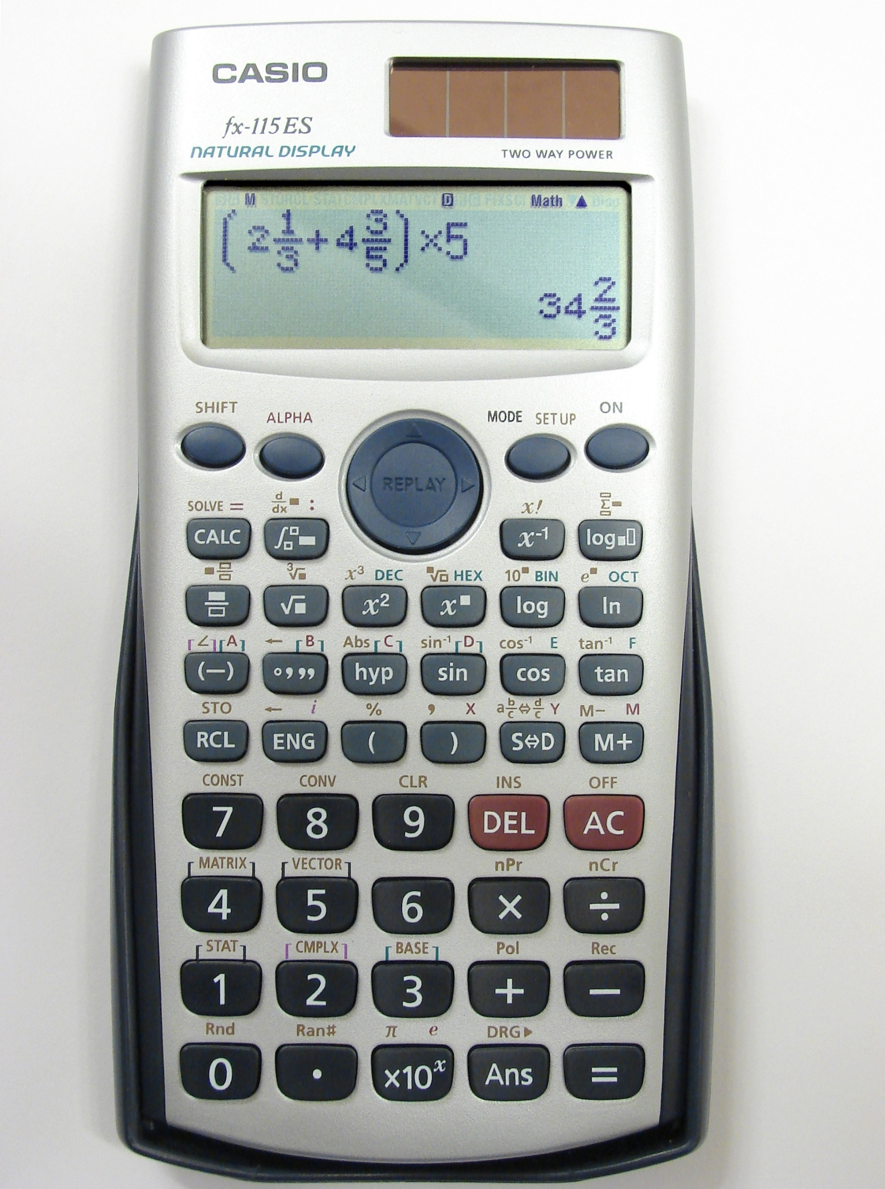
So which of these infinitely many behaviors should we check?
Divide the behaviors into regions of similar behavior.
It’s fair to assume that if one point in the region works, then the others will.
?

Slide 13

Make sure the regions have the right boundaries.
Select “special” values of a range
Boundary values;
Barely legal, barely illegal inputs;
Ignore others;
=> partition testing
Integer overflow a serious problem: may be implicit
ComAir problem due to a list getting more than 32767 elems
https://arstechnica.com/uncategorized/2004/12/4490-2/

Slide 14
Do our tests exercise all of the code?
This is the question of test coverage.
Statement coverage
Branch coverage
Path coverage
Quantitative measurement is possible.

Slide 15
Statement Coverage
There are good tools for this
Jest --coverage

Slide 16
Path Coverage
Sometimes a fault is only manifest on a particular path
E.g., choosing the left branch and then choosing the right branch. (dashed blue path)
But the number of paths can be infinite
E.g., if there is a loop.
There are ways to bound the number of paths to cover.

Slide 17
100% Coverage may be Impossible
Path coverage (even without loops)
Dependent conditions: if (x) A; B; if (x) C;
Edge coverage
E.g., if (x < 0) A; else if (x == 0) B; else if (x > 0) C;
Statement coverage
Dead code (e.g., defensive programming)

Slide 18
Mutation Testing
Mutation testing is a way of checking to see whether you’ve tested “enough” paths.
The code in the SUT is mutated
E.g., replacing “&&” with “||” in an “if” statement.
Then we see if the test suite fails.
If the test suite still passes, that means we don’t have enough tests.
Mutation testing is more than coverage, because it checks that the change made a difference.
Difficult in practice:
Too many mutants possible (time)
Too many mutants are equivalent or uninteresting:
rpc.set_deadline(10); ⟶ rpc.set_deadline(20);
But possible!
https://research.google/pubs/pub46584/

Slide 19
What if the purpose of your test suite is regression testing?
Regression tests control maintenance:
A change cannot be committed until “all” tests pass.
Often “all tests” means “all small automated unit tests”
Adequacy includes whether tests cover all uses:
Uses may include unspecified behavior:
E.g., Users may assume that a hash result is non-negative;
Hyrum’s law: any visible behavior may have dependents.
Users are responsible to add tests:
Beyoncé rule: “If you liked it you should have put a ring test on it” (SoftEng @ Google)

Slide 20

Adequacy of Acceptance Tests
Crucial: meet with prospective customers.
This is difficult, time-consuming and expensive.
But building the wrong product is much worse!

Slide 21

Supplement to Acceptance Evaluation
Dogfooding (“Eat your own dogfood”)
Be your own customer.
Weaknesses:
Employees unrepresentative of customers
Whether someone can be compelled to use a product does not say whether they would purchase it.

Slide 22
I don’t see how the slides past this point fit into the story.
Need to restate Learning Objectives here.

Slide 23


Testing Evaluates Software Systems
Validation: Are we building the right product?
Verification: Are we building the product right?

Slide 24
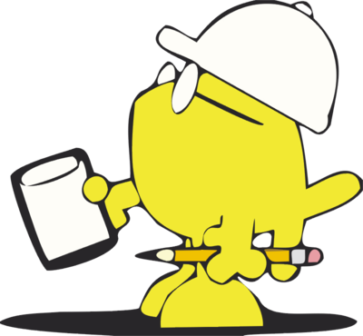
How Do We Evaluate Tests?
Purpose: Are tests checking the right things?
Adequacy: Are they checking the things right?

Slide 25
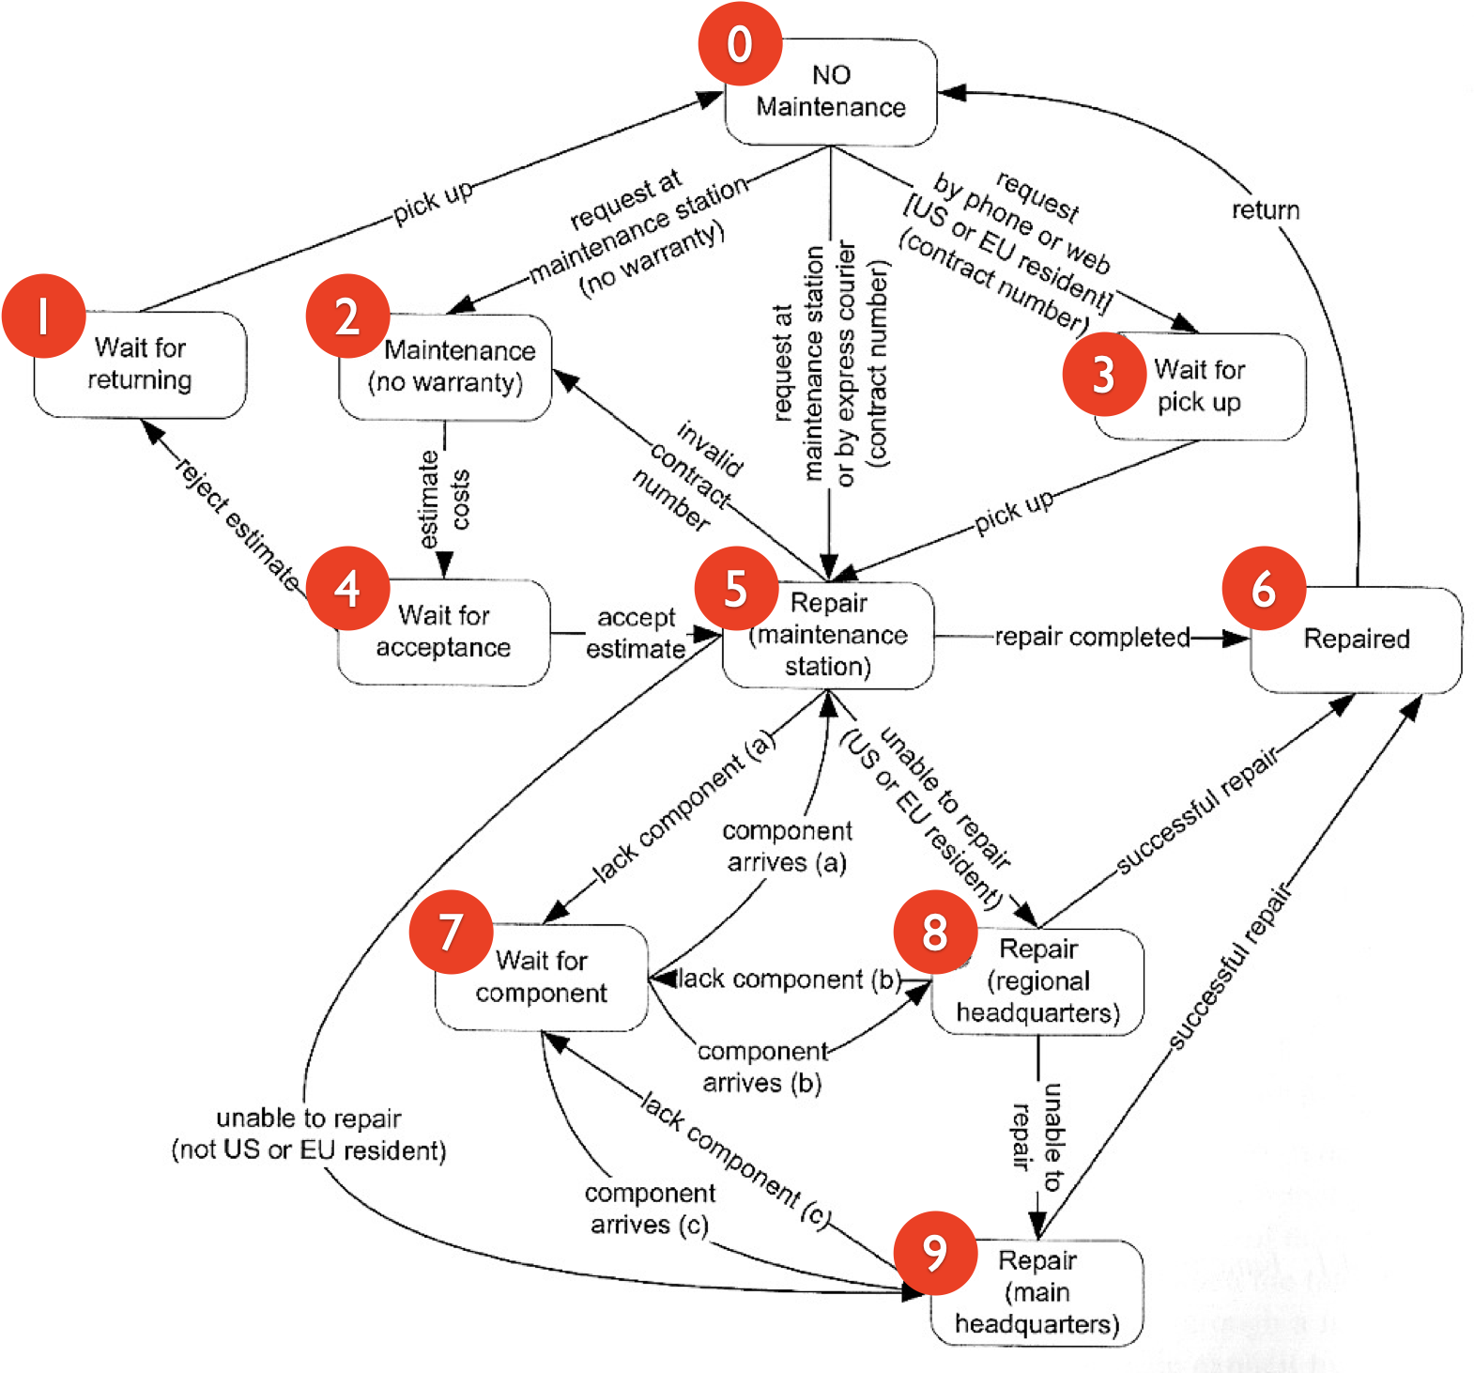
Coverage of Abstraction of SUT (3)
Abstract specification as a DFA
Then use Structural Testing over the abstraction.
Danger: system may be more complex than the model.
(from Pezze + Young, “Software Testing and Analysis”, Chapter 10)

Slide 26
Adequacy of Structural Testing
Structural Testing is also called “white-box testing.”
Purpose is to exercise code implementation.

Slide 27
Structural Testing Example (1)
Break function into basic blocks
Build a Control-Flow Graph (CFG)
int cgi_decode(char *encoded, char *decoded) {
char *eptr = encoded;
char *dptr = decoded;
int ok = 0;
while (*eptr) /* loop to end of string (‘\0’ character) */
{
char c;
c = *eptr;
if (c == ’+’) { /* ‘+’ maps to blank */
*dptr = ’ ’;
} else if (c == ’%’) { /* ’%xx’ is hex for char xx */
int digit_high = Hex_Values[*(++eptr)];
int digit_low = Hex_Values[*(++eptr)];
if (digit_high == -1 || digit_low == -1)
ok = 1; /* Bad return code */
else
*dptr = 16 * digit_high + digit_low;
} else { /* All other characters map to themselves */
*dptr = *eptr;
}
++dptr; ++eptr;
}
*dptr = ‘\0’; /* Null terminator for string */
return ok;
}
A
B
C
E
D
G
I
H
F
L
M

Slide 28
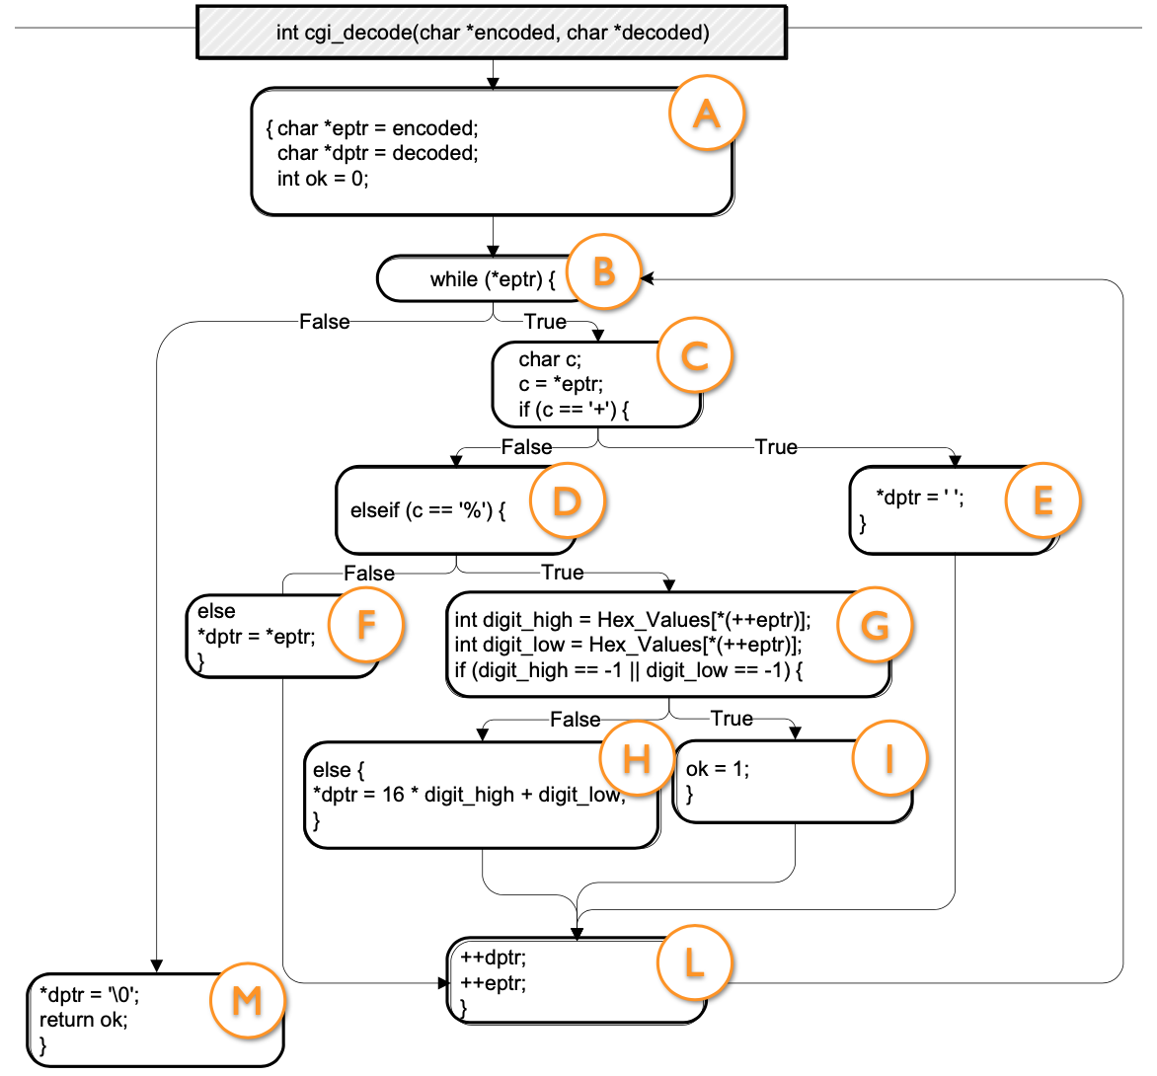
Structural Testing Example (2)
Evaluating Tests:
“test” (A,B,C,D,F,L,M)
“a+b” (A,B,C,D,E,F,L,M)
“%3d” (A,B,C,D,G,H,L,M)
“%g” (A,B,C,D,G,I,L,M)
Altogether, 100% block coverage
(first test could be omitted)
Also 100% branch coverage
If block “F” were absent, “%3d+%g” gets 100% block coverage while missing a branch.
(from Pezze + Young, “Software Testing and Analysis”, Chapter 12)

Slide 29
Structural Test Criteria
Path coverage (usually impossible) implies
Repetition-Free Path Coverage implies
Branch Coverage implies
Block Coverage = Statement coverage.
(Other coverage criteria exist, some incomparable)
See https://en.wikipedia.org/wiki/White-box_testing

Slide 30
Adequacy of Regression Tests (3)
“Test Smells” name problem aspects of tests:
“Smell” = “Disagreeable Odor” (metaphor)
Can be seen when reviewing tests;
Named (as Design Patterns) for communication.
Two lists of ”Test Smells”:
van Deursen et al. Refactoring test code
https://www.peruma.me/project/test-smells/
Smelly tests more likely to be flaky, brittle, mysterious or otherwise “bad.”
Some examples on next slides.

Slide 31
Review
Now that you've studied this lesson, you should be able to:
Describe measures of test suite adequacy, and to know their limitations;
Distinguish flaky and brittle tests;
Name several test smells, and give examples;
Explain some properties of good tests.

